Slide 1

Project Title -NETFLIX DATASET ANALYSIS
[SHARMILAA V ]
[INTERNSHIP_17546440516895be537820f]
[APPLY_175489717468999b16e5980]

Slide 2

PROBLEM STATEMENT
Netflix has become one of the most prominent global streaming platforms, continuously expanding its library with a mix of original productions and licensed content. However, with growing competition from platforms like Amazon Prime, Disney+, and regional OTT providers, Netflix must strategically analyze its content catalog to identify strengths, gaps, and opportunities.
The specific problem to be addressed in this project is 'Content Trends Analysis for Strategic Recommendations'. The aim is to uncover how Netflix’s content distribution (Movies vs. TV Shows, genres, and country contributions) has evolved over the years. This will enable the identification of key genres, audience preferences, and strategic insights into global content expansion.

Slide 3
Project Description
Understanding Netflix’s content trends is crucial for making data-driven business decisions. The analysis not only highlights the balance between Movies and TV Shows but also reveals popular genres and underrepresented categories. For a platform that serves diverse international audiences, country-wise contributions provide valuable insights into global representation and market penetration.
By focusing on these content trends, Netflix can refine its strategy for content acquisition and production, ensuring that it caters to the right audience segments while staying competitive in the global OTT industry.
Analyze the distribution of Movies vs. TV Shows over the years.
Identify the most common genres and how their popularity has changed.
Compare country-wise contributions to Netflix’s catalog.

Slide 4

WHO ARE THE END USERS?
Netflix Content Strategy Team
Marketing and Audience Research Teams
Business Intelligence and Data Analyst Teams
Content Acquisition And Production Managers
Executives and Decision Makers
Researchers or Students

Slide 5

Technology Used
Programming Language: Python (for data cleaning, analysis, and visualization).
Data Analysis Libraries: Pandas, NumPy (data processing and manipulation).
Data Visualization Tools: Matplotlib, Seaborn, Plotly (graphs, trends, and insights).
Database/Storage: CSV/Excel files (for storing and retrieving booking data).
Data Platforms: Google Colab and Julius AI (for analysis and reporting).

Slide 6
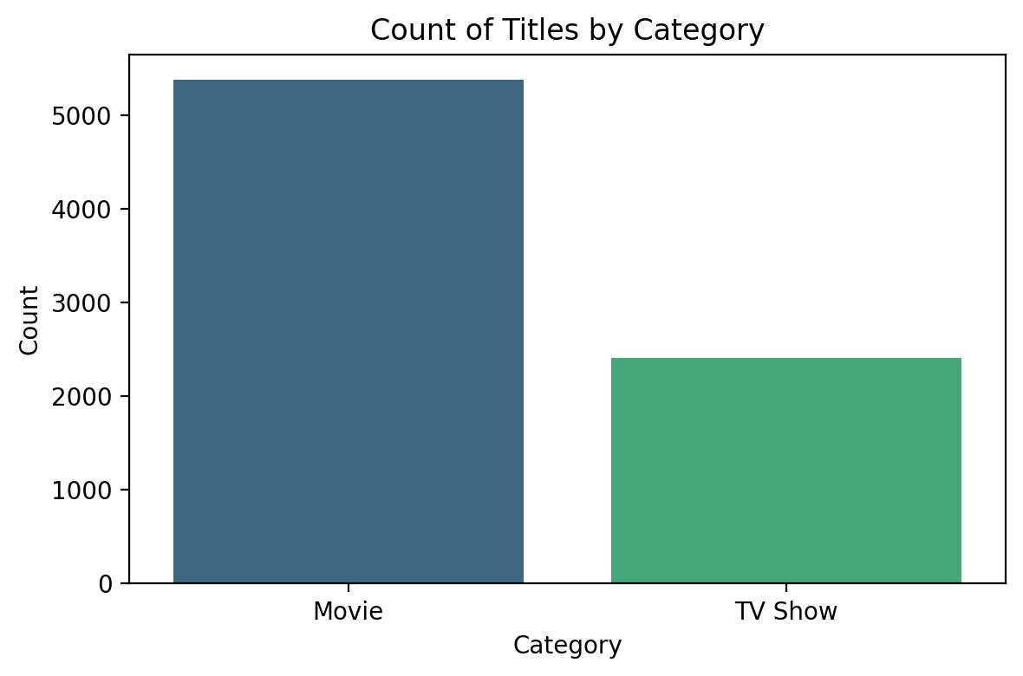
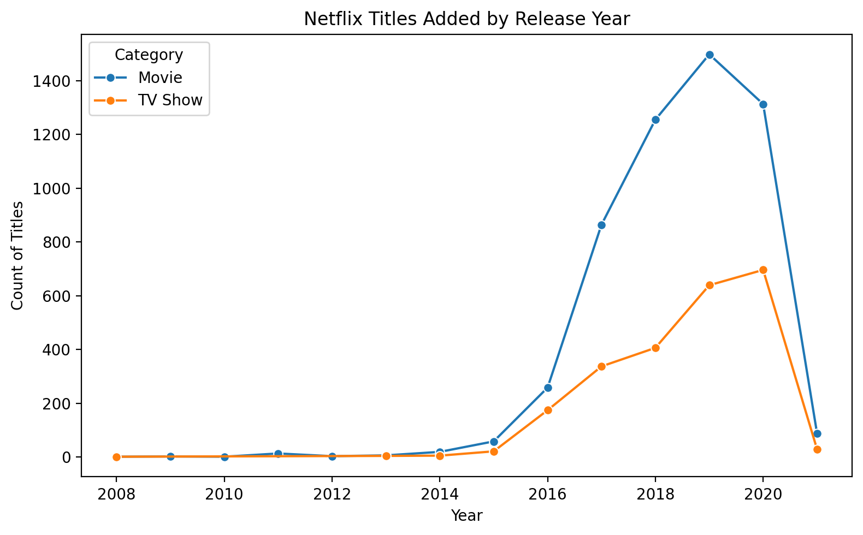
RESULTS1
[Add screen shots of your code or Chart(s) ]

Slide 7
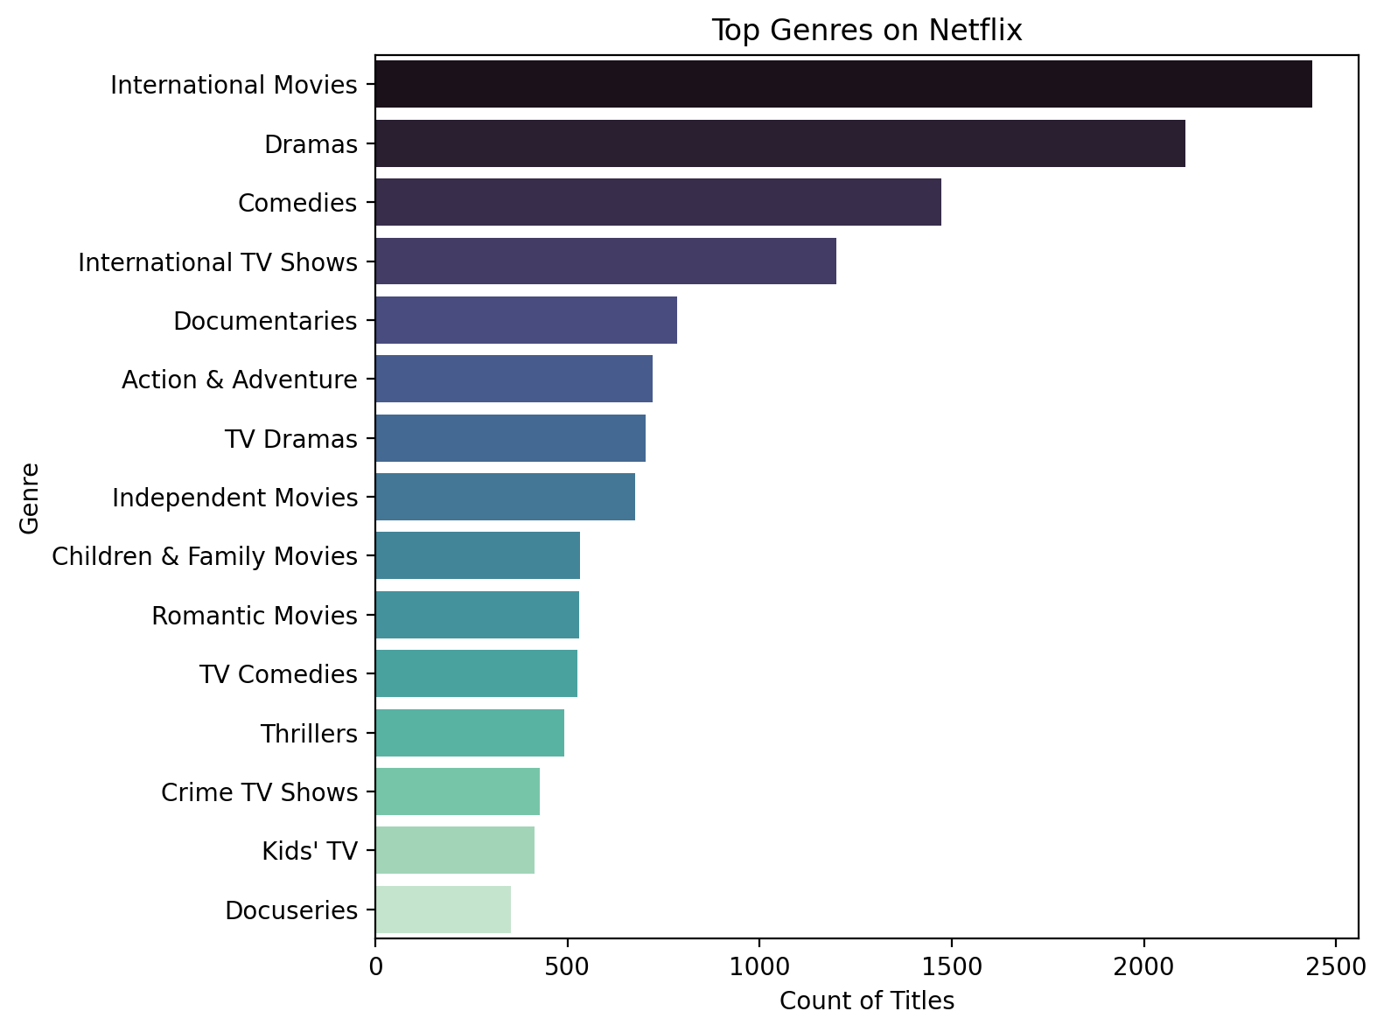
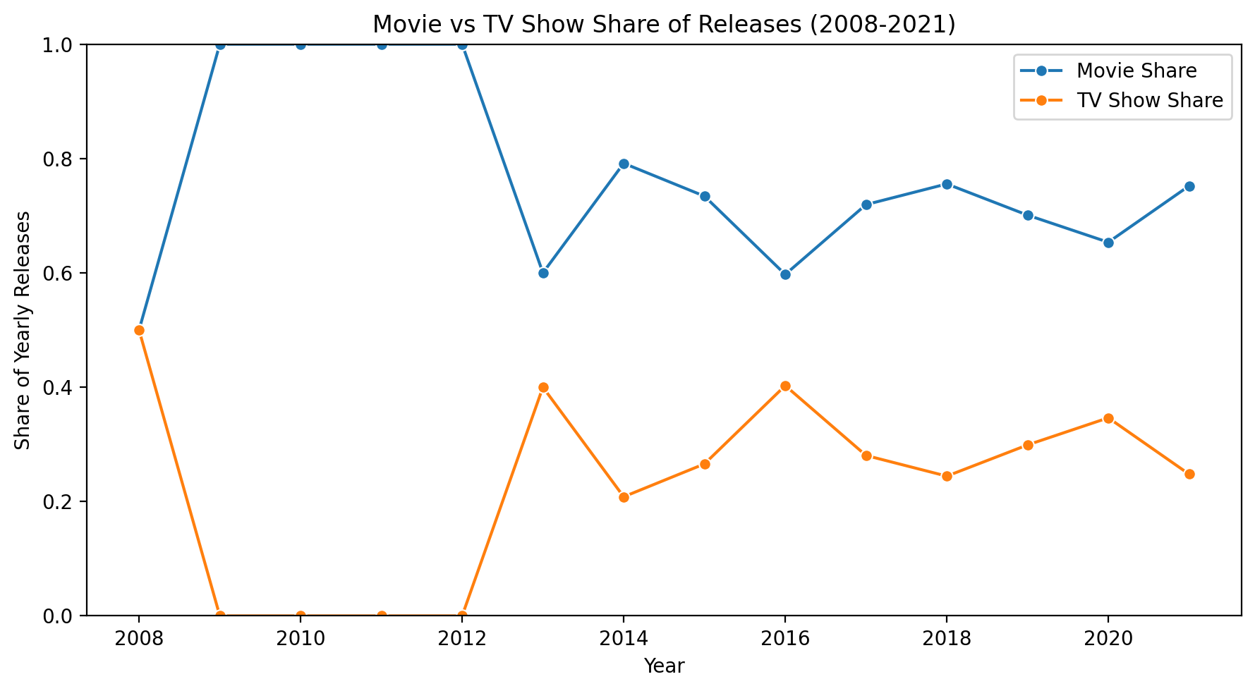
RESULTS2
[Add screen shots of your code or Chart(s) ]

Slide 8
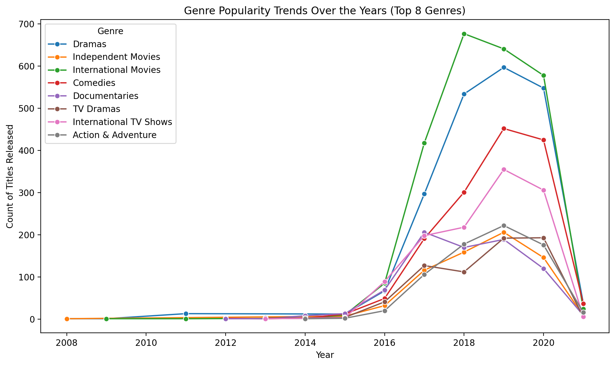
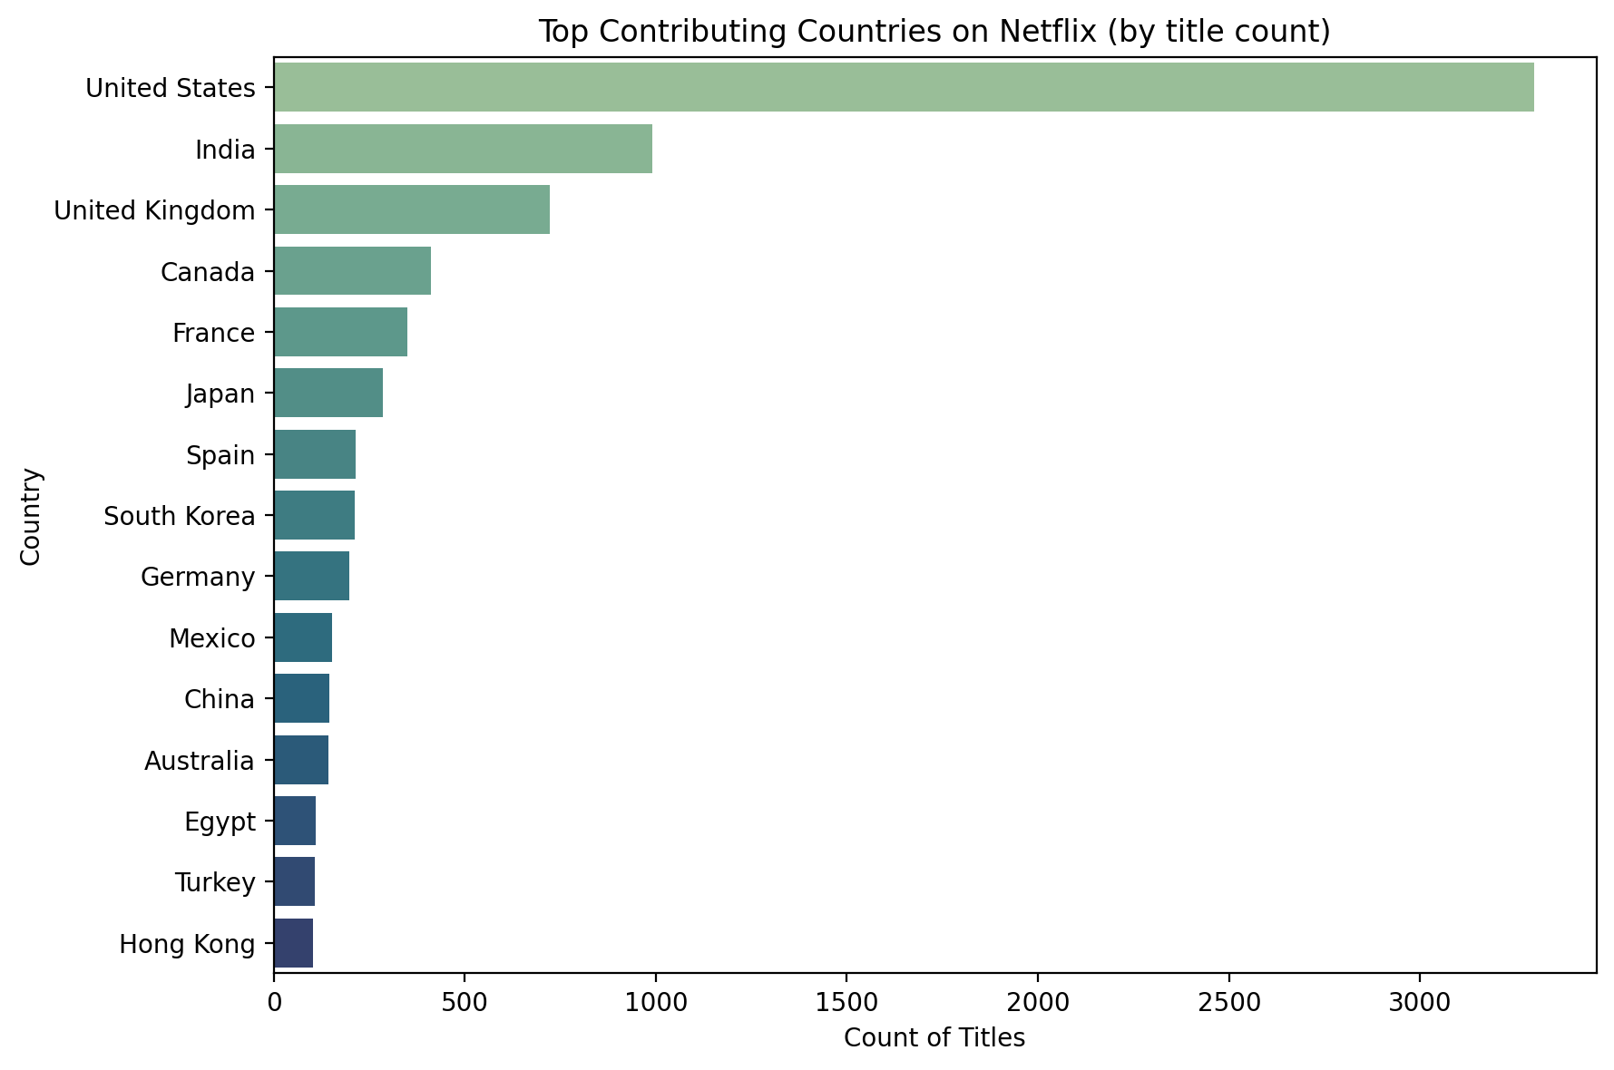
RESULTS3
[Add screen shots of your code or Chart(s) ]

Slide 9
GitHub repository
[https://github.com/Sharmilaa2004/VOIS_AICTE_Oct2025_MajorProject_Sharmilaa_V.git]

Slide 10
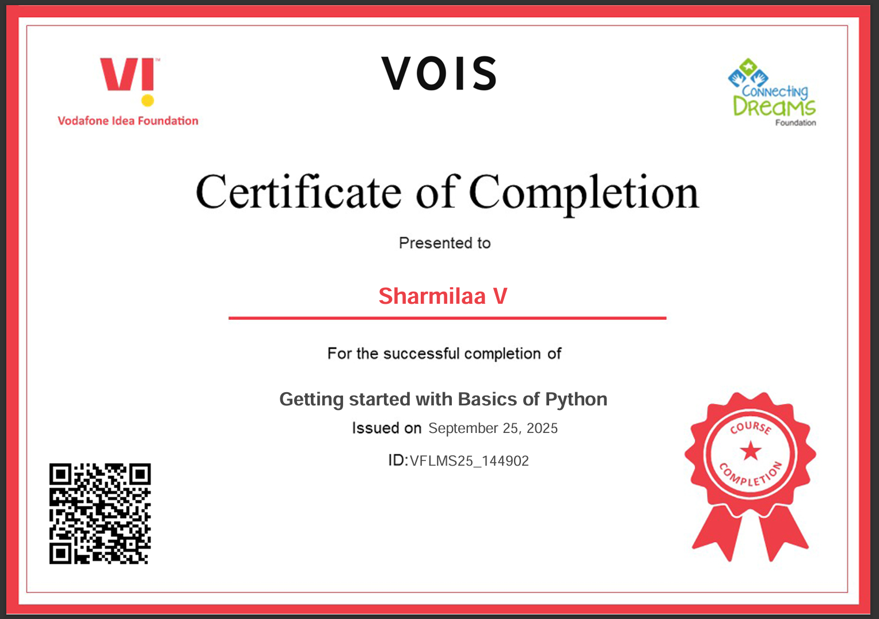
Getting started with Basics of Python Certificate
[Paste your Certificate Here]

Slide 11
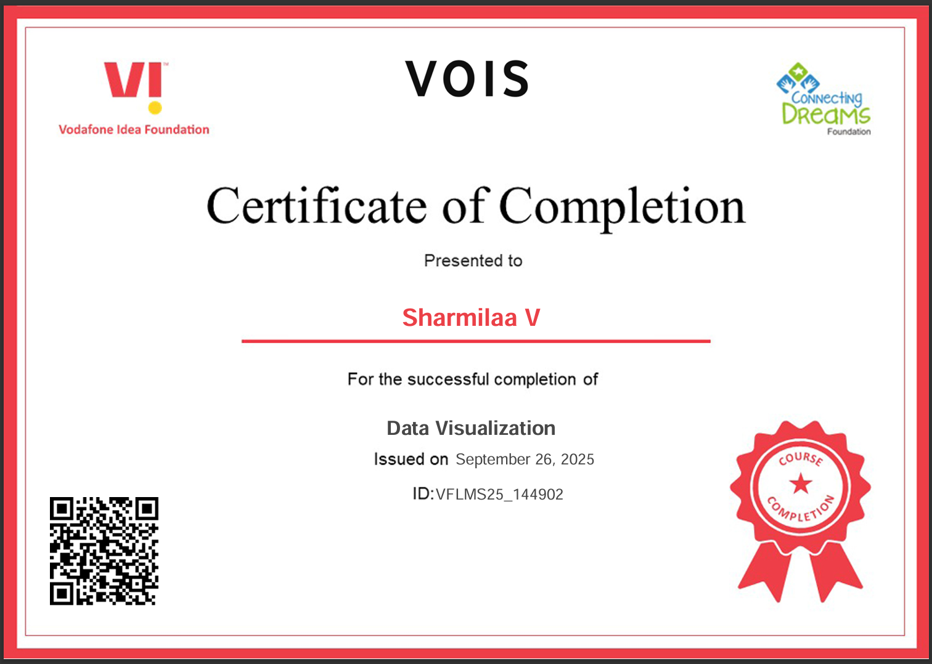
Data Visualization Certificate
[Paste your Certificate Here]

Slide 12
Thank you
.
.

